Slide 1
Avoiding Dangers
From Electricity
Christmas Lights and Live Electricity Wires
Because we care
This presentation is for information purposes only and is not to be circulated or disseminated without the prior consent of ESB Networks’ Public Safety Manager

Slide 2
Christmas Lights and Live Electricity Wires
ESB Networks is reminding everyone that the erection of Christmas Lights on electricity poles is strictly prohibited and poses a serious safety risk to members of the public as well as ESB Networks staff and contractors.
Every year ESB Networks receives reports of potentially dangerous safety incidents involving Christmas lights being installed near live electricity wires. Coming close to or making any contact with overhead electricity wires and associated pole top equipment is extremely dangerous and can be fatal. In these incidents, the people carrying out the work were at serious risk because these lighting strings may make contact with live electricity wires and become ‘live’ themselves.
It is important to note that you don’t have to make contact with overhead electricity wires to cause an electrical arc and discharge of electricity. Electricity can jump gaps.
Where Christmas lighting has already been installed near to live electricity wires, the immediate action required of the responsible person is to contact ESB Networks so that the lights can be removed safely. This may require that the electricity networks are de-energised before lights can be safely removed. Too frequently an initial dangerous act has been followed by a more dangerous one.
The ESB Networks Emergency Number is: 1800 372 999.
For its part, ESB Networks staff will remove such lighting where they become aware of them.
There is further safety information available on: Staying Safe (esbnetworks.ie).
The important safety message is always to Stay Safe, Stay Clear of Electricity Wires.

Slide 3
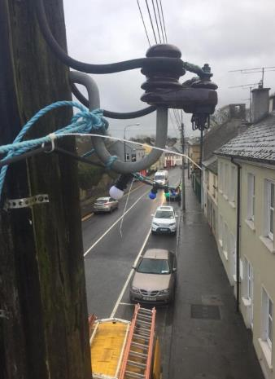
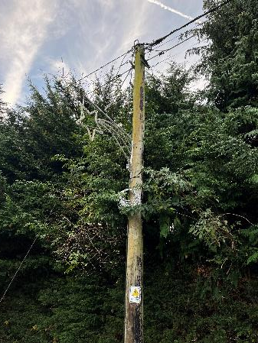
Christmas Lights and Live Electricity Wires
Christmas lights attached adjacent to live parts of ESB Networks Overhead lines.
Always
Stay Safe & Stay Clear
of Electricity Wires.
ESB Networks is reminding everyone that the erection of Christmas Lights on electricity poles is strictly prohibited and poses a serious safety risk to members of the public as well as ESB Networks staff and contractors.

